Slide 1
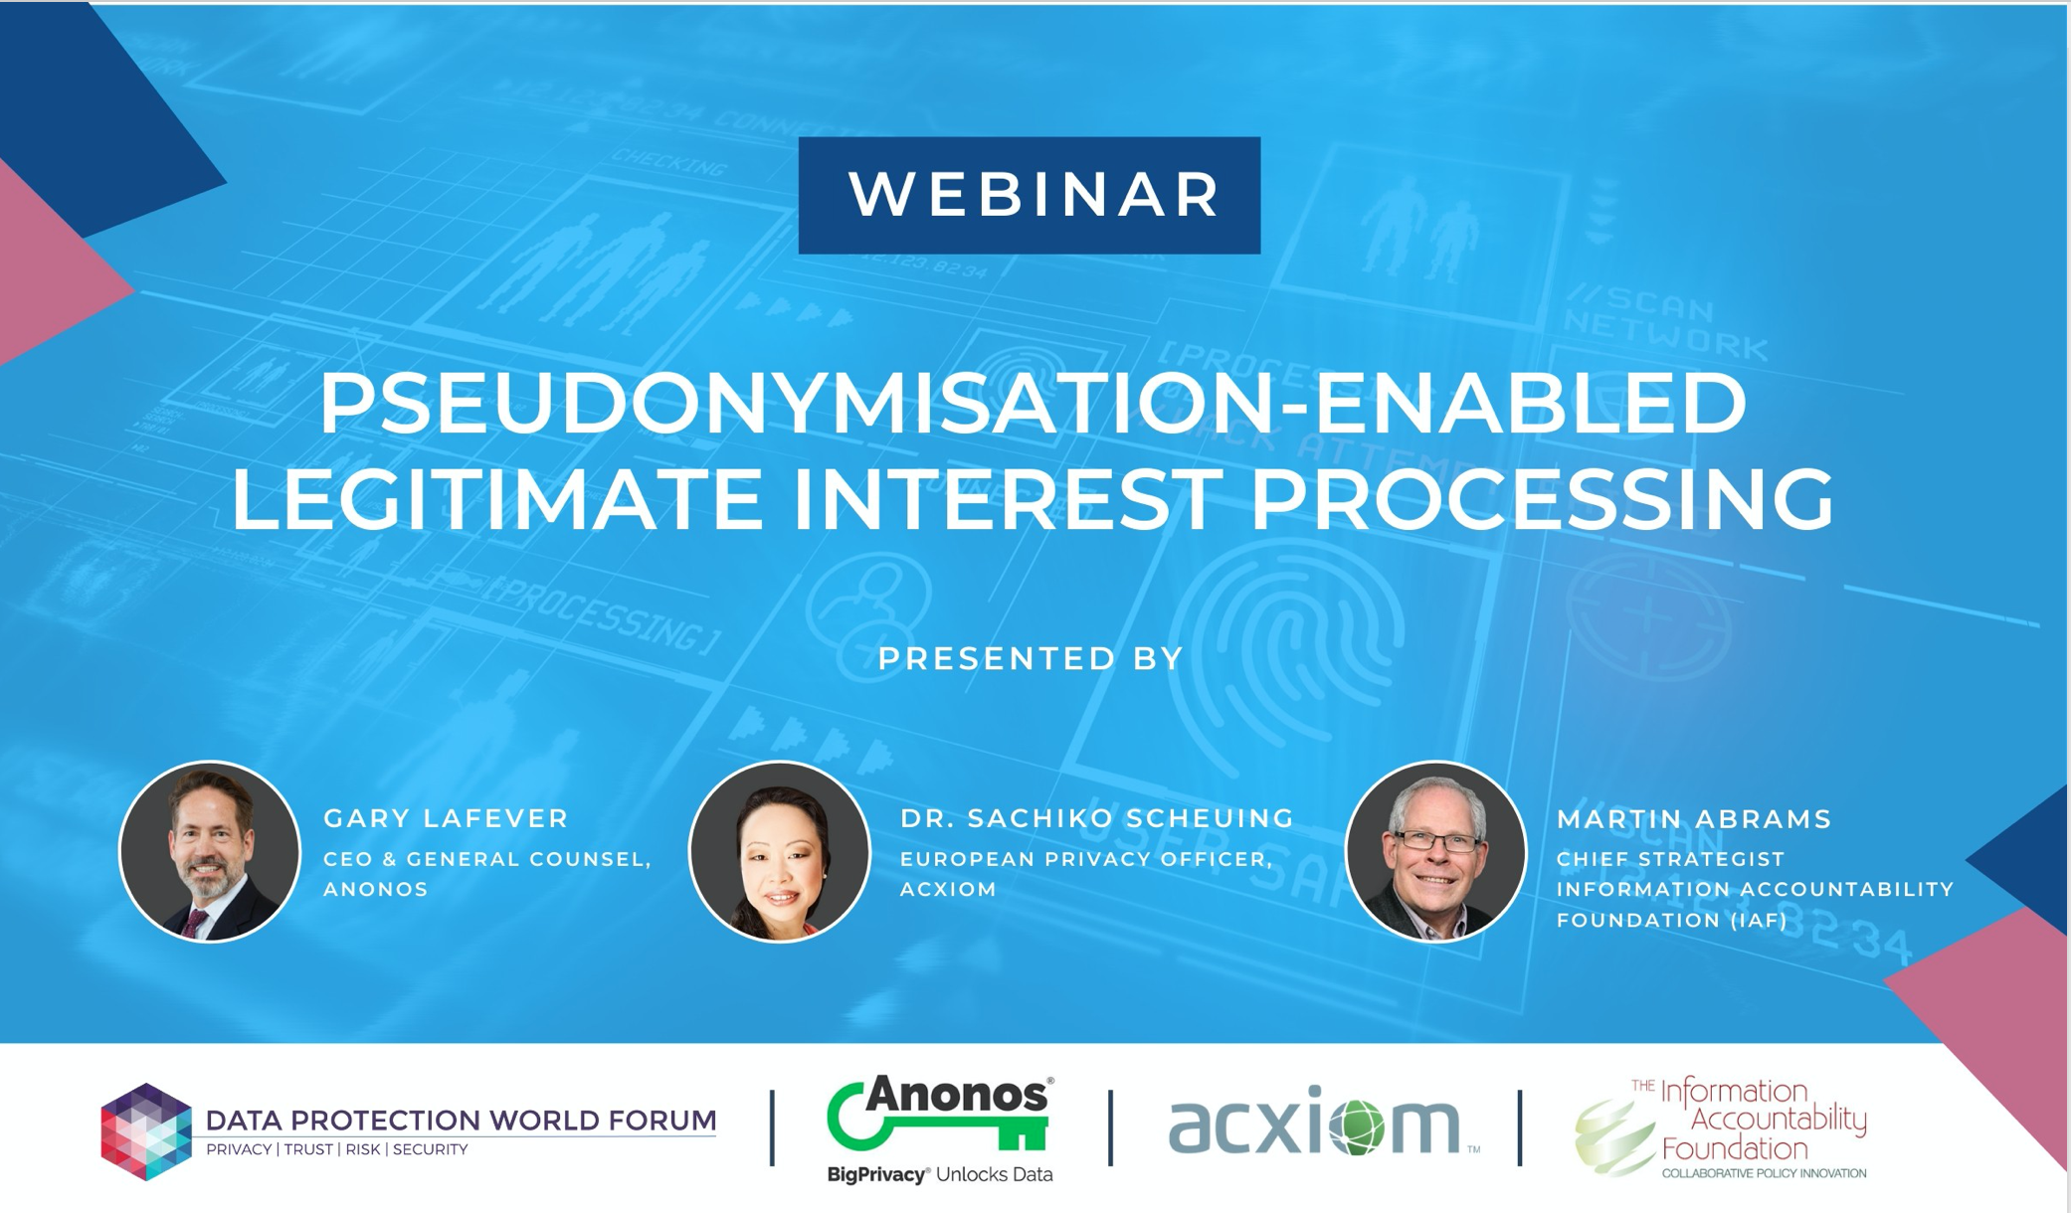

Slide 2

If You Can’t Answer YES to All of These Questions,
You Must Stop Personal Marketing
Does your organisation use technology that demonstrably and verifiably enforces policies that protect data when in use?
Example: Do you have technical controls that transform data while enforcing privacy protection policies for data in use?
Encryption only protects data at rest and in transit, not in use.
1
Does your organisation use dynamically changing de-identifiers?
(www.MosaicEffect.com)
Example: Relinking to identity should only be possible with the use of separately-kept “Additional Information.” Static tokens that are consistent across data are vulnerable to re-identification via linkage attacks, referred to as the Mosaic Effect. This means that you need to use dynamically-changing identifiers instead.
2
Does your organisation’s technology satisfy new statutory requirements to get the benefits of Pseudonymisation?
(www.Pseudonymisation.com)
Example: Relinking to identity should only be possible with the use of separately-kept “Additional Information.” Use of static tokens and a failure to protect indirect identifiers could result in unauthorised relinking to identity, increasing the possibility of unlawful processing of personal data.
3
Does your organisation’s Pseudonymisation technology satisfy new EU technical standards?
(www.ENISAguidelines.com)
Example: Not using state-of-the-art techniques for pseudonym generation and supplementing Pseudonymisation with anonymisation techniques results in data being vulnerable to unauthorized re-identification.
4
2
© Anonos 2020. All Rights Reserved

Slide 3




Case Study: How to Avoid Advertising With NO Personalization or Even Minimal Analysis.
State of the art Pseudonymisation – as newly defined under the GDPR – helps to overcome shortcomings of:
Consent
Contract
Anonymisation
to enable use of Legitimate Interest processing to dissuade regulators from eliminating personalized segment-based marketing (leaving marketers with only context-based marketing) and limiting other innovative uses of personal data.
Male
Middle Age
John J. Jeffries
47
Information Value
Identity
Additional Information

Slide 4

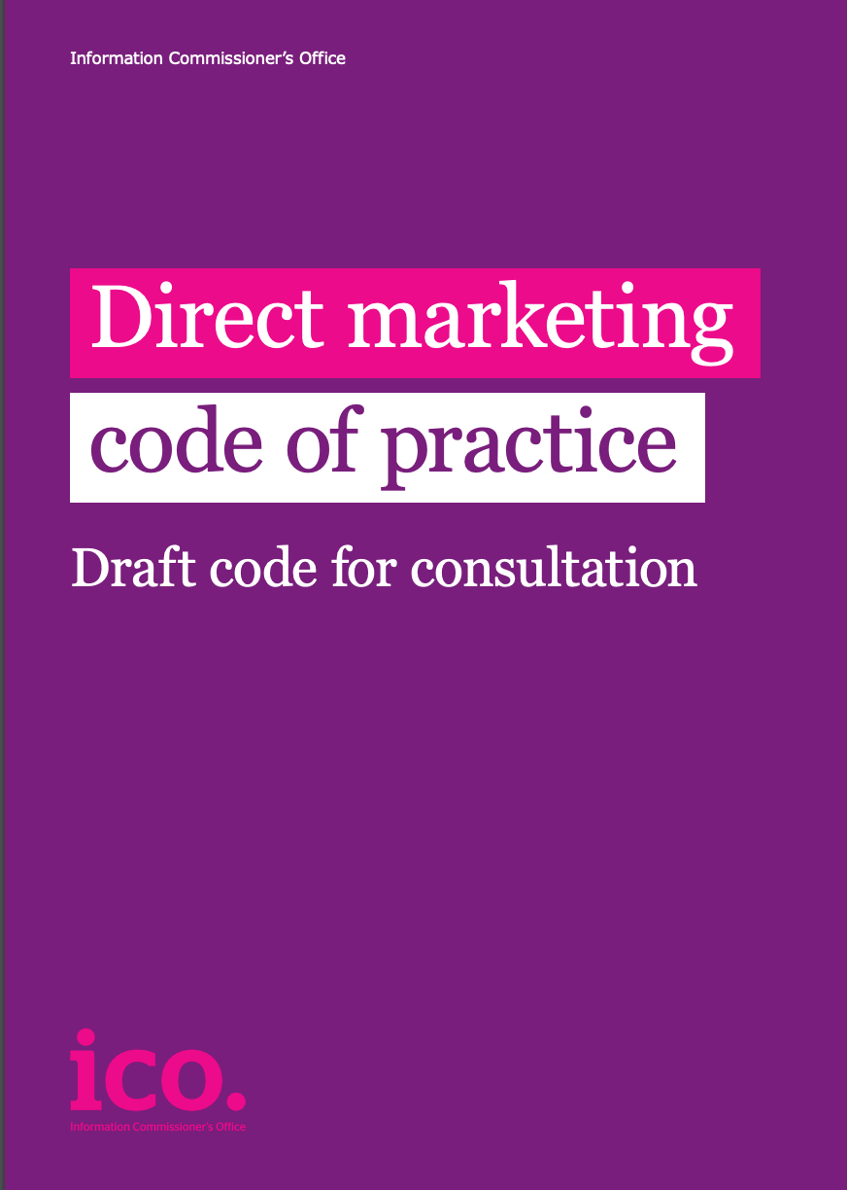
Pseudonymisation-Enabled Legitimate Interest Processing
Case Study: Impact of ICO Direct Marketing Code on Segment-Based Marketing
The ICO Draft Direct Marketing Code is consistent with prior guidance from the Article 29 Working Party, its successor the European Data Protection Board (or EDPB), and other Data Protection Authorities that organizations CANNOT continue to engage in data processing activities – even those that have been common practice for years – if those practices fail to satisfy new requirements under the GDPR.
The ICO Draft Code highlights the importance of consent under the UK Privacy and Electronic Communications Regulation (PECR) as well as the GDPR.
1
2
However, comment letters submitted in response to the Draft Code highlight the danger if:
Consent is the ONLY legal basis for
direct marketing
All profiling is considered automated decision with legal or similar effect.

Slide 5


Comment Letters Filed in Response to ICO Draft Code
Internet Advertising Bureau (IAB) Comment Letter to ICO
The Draft Code has a general negative bias against marketing as if it is a nefarious activity…. The document generally favours consent and suggests that LI is always the more difficult option….By more or less denying legitimate interest for marketing purposes, ICO is ignoring the fundamental premise of the GDPR and the EU Charter of Fundamental Rights…. differentiation should be made for cases where technical and organisational measures are taken where profiling is conducted.
The ICO should not be prescriptive about which legal bases are or are not available for a particular processing activity…. We do not agree that ‘if PECR requires consent then in practice consent will be your lawful basis under the GDPR’….Our view is that subsequent processing of personal data is subject to the legal basis provisions of the GDPR. Legitimate interest is therefore a possible legal basis for processing personal data in these circumstances.
Data & Marketing Association (DMA) Comment Letter to ICO
Pseudonymisation, for instance, helps marketers gain insights into their client base while the identities of the data subjects are protected… Consent provides a stronger level of permission initially and acts as a “gateway” for subsequent Legitimate Interest use.

Slide 6
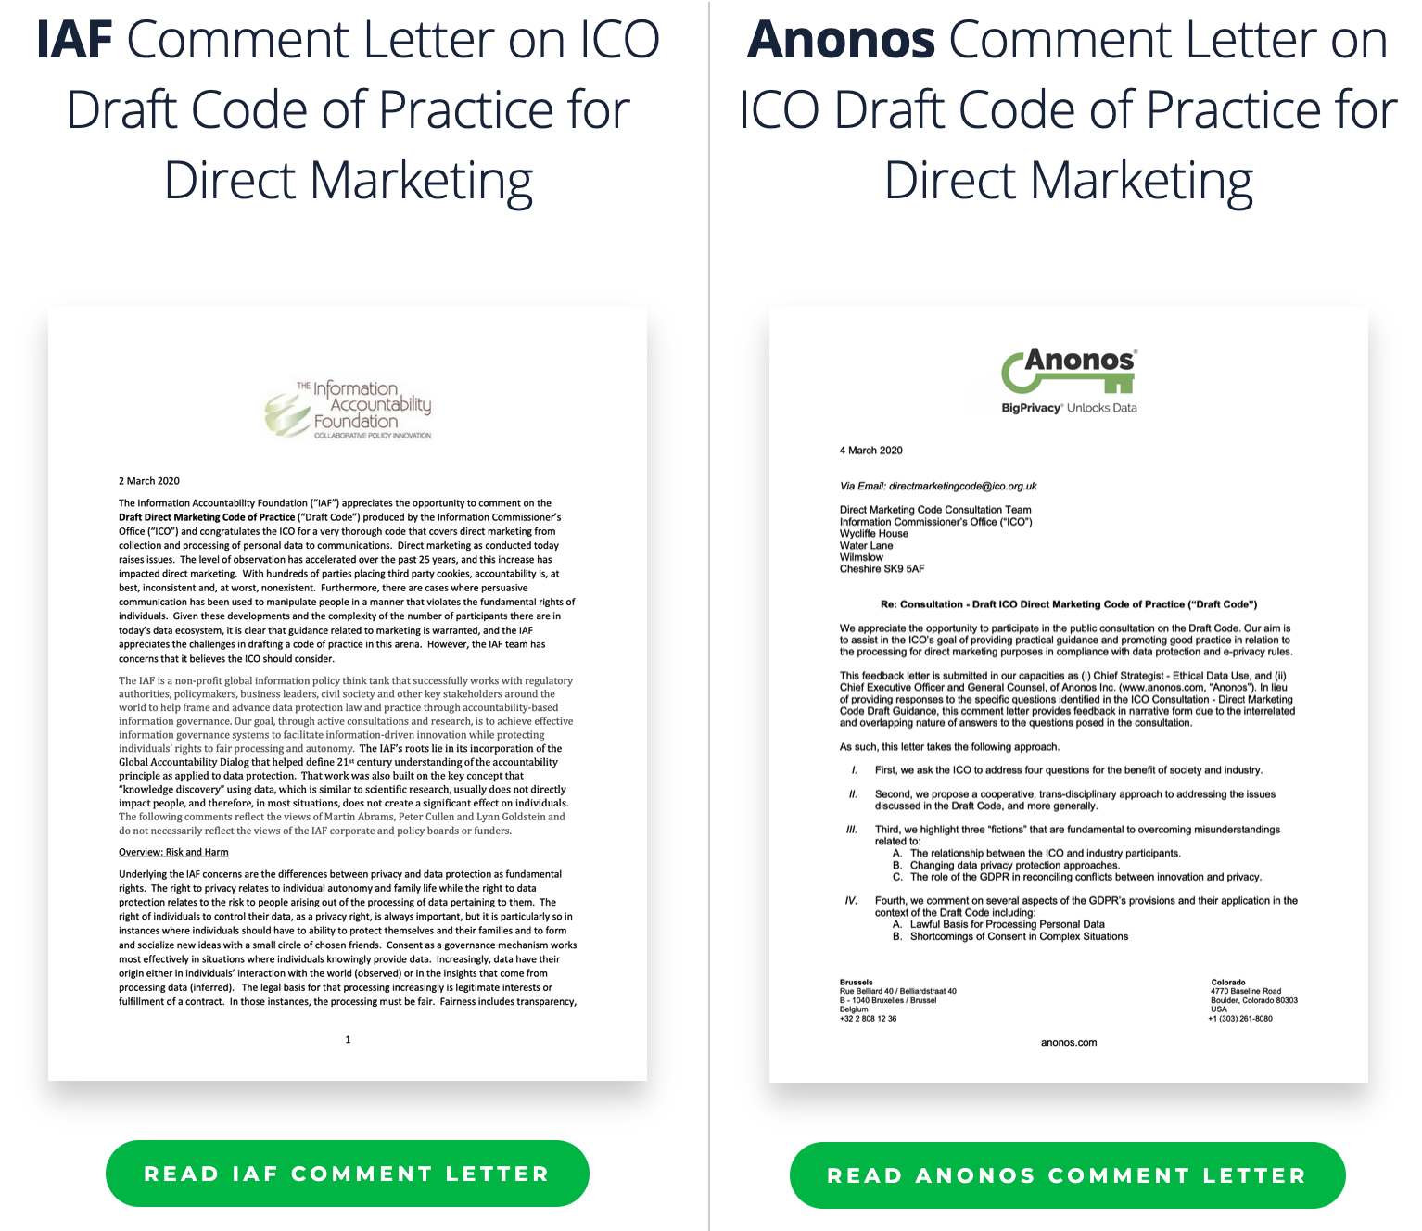
IAF and Anonos Comment Letters to ICO
Four Critical Questions for Direct Marketing
1
3
May different legal grounds co-exist to support separate processes comprising lawful direct marketing, or must a single, unitary legal basis be established to support all end-to-end processing steps (e.g., collection, analytics, outreach, etc.) of personal data for direct marketing?
Can the further processing of personal data for direct marketing purposes be based on Legitimate Interests when supported by pseudonymised microsegments to respect and enforce the fundamental rights of data subjects?
2
4
Can direct marketing itself serve as the purpose for which data is collected based on consent?
Does all profiling necessarily constitute automated decision making?
www.microsegmentation.com/ico

Slide 7



ICO Code of Practice & Direct Marketing
Consent Only Processing
vs
Consent & Legitimate
Interests Processing
1
2
3
The ICO Draft Code of Practice for Direct Marketing highlights an increased focus by Data Protection Authorities on direct (segment-based) marketing practices.
Without concrete initiatives on the part of industry to show that direct marketing can coexist with strong privacy protections, it is a near certainty that regulatory developments threaten direct marketing.
To lawfully continue direct marketing, Legitimate Interests processing is required as a complement to consent, necessitating new technical capabilities not supported by technologies developed prior to the GDPR. Pseudonymisation – as newly defined under the GDPR – helps solve the situation.
NOTE: Austria and Italy have Codes of Conduct that specifically authorize Legitimate Interest processing.

Slide 8

The New GDPR Reality for Data Repurposing
YOU CAN NO LONGER
RELIABLY COUNT ON:
1. CONSENT
2. CONTRACT
Data Assets Unavailable
for Lawful Repurposing
3. ANONYMISATION
FOR LAWFUL REPURPOSING OF OR SHARING OF DATA IN MANY INSTANCES
Consent, Contract & Anonymisation May No Longer Get You Where Need to Go

Slide 9








Regulators Limiting Scope of Consent, Contract, Anonymisation
Cannot Use Consent for GDPR Legal Basis for Scientific Research
Consent/Contract Not Enough
European Data Protection Supervisor
Danish DPA
Hellenic DPA
EDPS reaffirms and re-enforces EDPB guidance that informed consent does not provide lawful basis for processing personal data under the GDPR even though required under clinical trial laws.
Danish Data Protection Authority (Datatilsynet) rules that deleting names but retaining persistent identifiers is inadequate protection of personal data.
The Hellenic Data Protection Authority fines PwC for illegal processing of personal data of employees since consent not freely given due to imbalance of power under employment contracts.
YOU CAN NO LONGER RELY ON:
Criminal Liability for Re-ID
Consent
Contract
Anonymisation
Italian DPA
UK Data Protection Act
USA
Italian Data Protection Authority (Garante) rules that deleting telephone numbers while retaining persistent identifiers exposes data subjects to unlawful privacy risk.
Section 171(5) of The Data Protection Act 2018 enacting GDPR makes it a criminal offence to knowingly or recklessly process personal data containing information that has been re-identified after being de-identified.
FTC settles with Facebook for US $5 Billion in connection with the Cambridge Analytica data use scandal and failures to protect data privacy.
FOR MANY LAWFUL SECONDARY USES
Cannot Use Consent/Contract
Anonymisation Must Be Absolute
Dutch DPA
UK DPA
Spanish DPA
Dutch Data Protection Authority (Autoriteit Persoonsgegevens) guidance that banks cannot use their own transaction data for marketing to customers based on general consent or contract with data subjects.
UK Data Protection Authority (ICO) announces fines of US$230 Million against British Airways and US$123 Million against Marriott for data protection failures.
Joint Agencia Española de Protección de Datos (AEPD) and European Data Protection Supervisor (EDPS) guidance that not even the data controller can be capable of re-identifying data holders in an anonymised dataset.

Slide 10
Anonymisation: Can You Guarantee No Re-Identification?
1
INTENDED PROCESSING
START
Y
= YES
CONTRACT
CONSENT
7
STOP: CANNOT PROCESS
N
N
= NO
Only what is needed to fulfill contract?
Data Subject free to say “No”?
N
6
ANONYMISATION
LEGITIMATE
INTEREST
Y
Y
Can you guarantee no re-identification
if combined with other data?
Do you only protect data at rest and in transit using encryption?
Do you combine encryption with only traditional Privacy Enhancing Techniques?
Do you use GDPR compliant Pseudonymisation?
Data Subject has equal negotiating power?
Must Satisfy Balancing of Interests Test
N
N
N
N
5
Y
Y
Y
Can processing
be described
with specificity?
Can you guarantee limited to siloed processing only?
4
Y
Y
Y
Y
Y
Primary Use
Narrowly construed to what is strictly necessary to perform contract
Primary Use
Any changes to specific disclosed processing require re-consent each time
Risky & No Relinkability
Failure to satisfy requirements = exposure to fines and sanctions
GDPR Express Statutory Benefits
plus
Lawful Sharing and Combining Across
Regulatory and Entity Boundaries
2
3
Limited Utility
Siloed Processing
No sharing or combining across regulatory or entity boundaries
9
8
4
Repurposing Desired?
N
End

Slide 11

Demonstrable - Technically Enforced - Accountability
Requires
Availability of granular technical privacy controls that protect data when in distributed use by design and by default.
This is much more than:
Development of and/or modification of policies, frameworks and organizational controls at a detailed level leveraging technical controls in #1 to enable granular enforcement by design and by default.
Verifiable, auditable and demonstrable proof that the controls in #1 above enforce the policies and framework in #2 above to show certainty and predictability of compliance to customers, partners and regulators.
Consent
Contract
Anonymisation
(via enclave/controlled processing
for “local anonymisation”).
Pseudonymisation as newly defined in Section 4(5) of the GDPR requires the separation of the information value derived from processing activities from the ability to re-identify data subjects
using direct or indirect identifiers. The definition also requires that re-identification can only occur via access to separately stored “Additional information” in support of authorized purposes.

Slide 12




Increase Data Value with Legitimate Interests Processing
These Days Are Gone Forever
Limited Value Processing
Maximum Data Value
The Days of Free Market
Direct Marketing
ARE OVER
Consent-Only
Based Marketing
Pseudonymisation-
Enabled Legitimate Interests Marketing

Slide 13
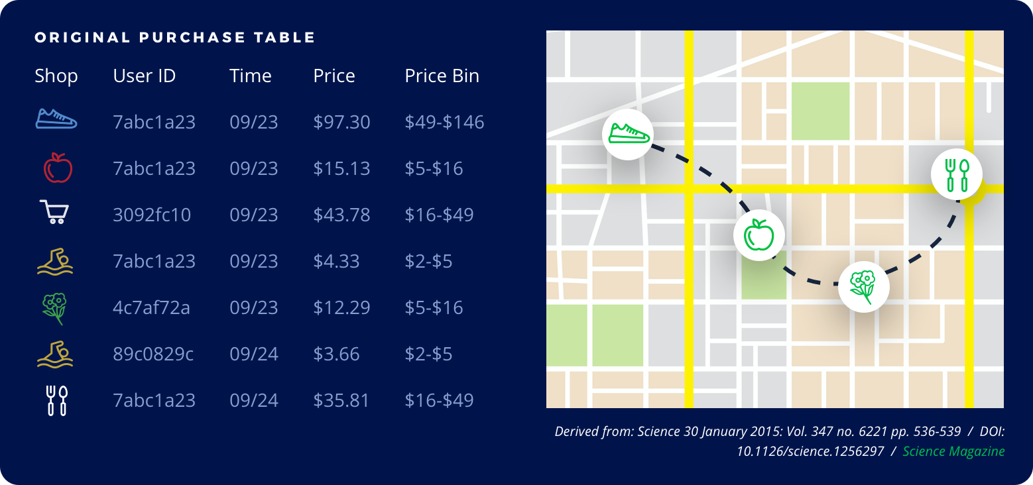
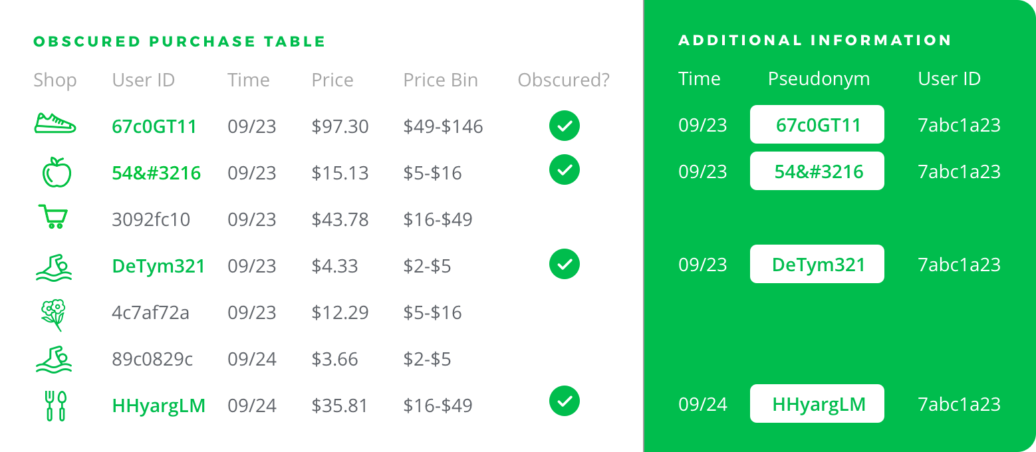
Anonymisation vs GDPR Pseudonymisation
Anonymisation and pre-GDPR forms of tokenisation (sometimes incorrectly referred to as pseudonymisation) use persistent or static tokens to replace data values can be readily used to re-identify data subjects via the Mosaic Effect without requiring access to “Additional Information” stored separately by the data controller.
Pseudonymisation as newly defined under the GDPR requires protection of both direct and indirect identifiers so that personal data is not cross referenceable (or re-identifiable) without access to “Additional Information” kept securely by the controller to defeat the Mosaic Effect.
Check Out Interactive Tool at www.MosaicEffect.com

Slide 14

Pseudonymisation Benefits Under GDPR
1. Tips the balance in favor of Legitimate Interests¹
2. More flexible change of purpose²
3. More expansive data minimisation³
4. More flexible storage limitation⁴
Only GDPR-Compliant Pseudonymisation Can Produce Desired Legal Effects
5. Enhanced security⁵
Applying pre-GDPR forms of tokenisation (sometimes incorrectly referred to as pseudonymisation) techniques will not comply with new GDPR requirements for pseudonymisation, which impose new criteria that must be satisfied to benefit from the desired legal effects.⁹
Under the GDPR, pseudonymisation must ensure that, after identifying information has been substituted, information in the data set can no longer be attributed to a specific individual (via inference, singling out or linking) without the use “Additional information” that is kept separately.
“Separately” does not mean held by a third party. Proper data ‘siloing’ within a single company can ensure that Additional Information is isolated from the rest of the organisation, so that it cannot be combined with Pseudonymised information except for authorized processing.¹⁰
6. More expansive further processing⁶
7. More flexible profiling⁷
8. Ability to lawfully share and combine data⁸
¹Art 5(1)(a), 6(1)(f), WP 217; ²5(1)(b), WP 203; ³5(1)(c), 89(1); ⁴5(1)(e), 89(1); ⁵5(1)(f), 32; ⁶6(4), WP 217; ⁷WP 251rev.01 - Annex 1 - Good Practice Recommendations, Art 22, Rec 71; ⁸Art 11(2), 12(2); ⁹Art 4(5); ¹⁰Rec 29

Slide 15
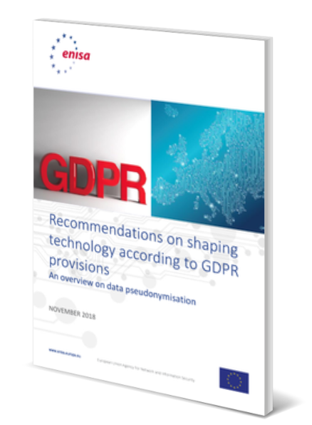
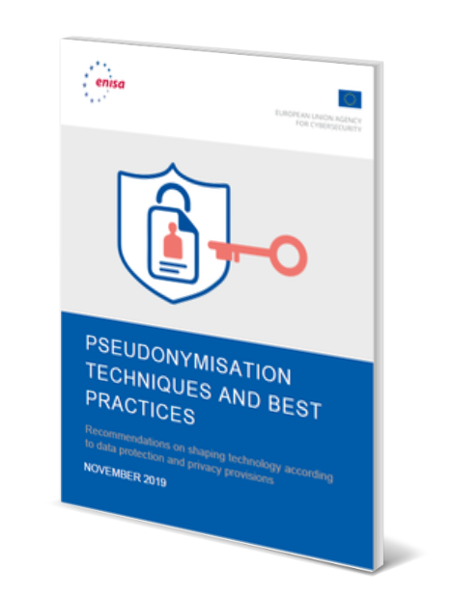
GDPR Pseudonymisation = Technical & Organisational Controls
GDPR Definition of Pseudonymisation
1) Information Value cannot be re-linkable to Identity of data subject without the use of Additional Information that is kept separately, subject to technical and organisational measures.
2) Access to and use of Additional information must be limited to authorized lawful processing only.
Male
Middle Age
John J. Jeffries
47
Information Value
Identity
ENISA Guidance on Pseudonymisation
November
2018
Additional Information
November
2019
See ENISA Guidance Requirements at www.ENISAGuidelines.com
Notes:
15

Slide 16


How the Dutch Data Protection Authority (AP) Allows
Legitimate Interests Processing
Pseudonymisation-Enabled Legitimate Interests would produce a different result for KNLTB.
A full reading of the text of the AP decision reveals that rather than holding that commercial interests can never support Legitimate Interest as a legal basis, paragraphs 137 and 141 clarify that:
  Entrepreneurs...have...duties of care for...their customers. These are laid down in concrete or general legal standards. Being able to give substance to this is a legitimate interest.
  [T]he KNLTB does not flesh out concrete or general legal standards that relate to its duty of care as an "entrepreneur.”
  The AP therefore concludes that neither the interests stated by the KNLTB nor the interests designated by the AP qualify as justified.
3. Demonstrable - Technically Enforced - Accountability supporting data minimisation, purpose limitation, and Data Protection by Design and by Default using GDPR Pseudonymisation, together with proper notice to data subjects enables Legitimate Interests processing as a valid legal basis.
16

Slide 17



Mark Your Calendar For The Next Webinar on April 9th
Pseudonymisation-Enabled Legitimate Interest MicroSegmentation-Based Direct Marketing
1
2
3
DATA
COLLECTION:
CONSENT-BASED
DATA SUBMISSION WITH
NOTICE OF LEGITIMATE INTEREST
PROCESSING TO FOLLOW
DATA SCIENCE/
ANALYSIS:
LEGITIMATE INTERESTS-BASED
PROCESSING
CUSTOMER ENGAGEMENT/
INTERACTION:
LEGITIMATE
INTERESTS &
CONSENT-BASED PROCESSING
(Profiling that does not have a “legal effect”)

Slide 18
If You Can’t Answer YES to All of These Questions,
You Must Stop Personal Marketing
Does your organisation use technology that demonstrably and verifiably enforces policies that protect data when in use?
Example: Do you have technical controls that transform data while enforcing privacy protection policies for data in use?
Encryption only protects data at rest and in transit, not in use.
1
Does your organisation use dynamically changing de-identifiers?
(www.MosaicEffect.com)
Example: Relinking to identity should only be possible with the use of separately-kept “Additional Information.” Static tokens that are consistent across data are vulnerable to re-identification via linkage attacks, referred to as the Mosaic Effect. This means that you need to use dynamically-changing identifiers instead.
2
Does your organisation’s technology satisfy new statutory requirements to get the benefits of Pseudonymisation?
(www.Pseudonymisation.com)
Example: Relinking to identity should only be possible with the use of separately-kept “Additional Information.” Use of static tokens and a failure to protect indirect identifiers could result in unauthorised relinking to identity, increasing the possibility of unlawful processing of personal data.
3
Does your organisation’s Pseudonymisation technology satisfy new EU technical standards?
(www.ENISAguidelines.com)
Example: Not using state-of-the-art techniques for pseudonym generation and supplementing Pseudonymisation with anonymisation techniques results in data being vulnerable to unauthorized re-identification.
4
18
© Anonos 2020. All Rights Reserved

Slide 19
Webinar:
Pseudonymisation-Enabled Legitimate Interest Processing
Questions & Answers
LearnMore@Anonos.com

